Slide 1
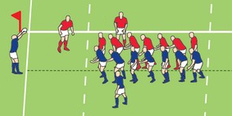
Notre en but + nos 22m
Leur 22m + En but adverse
22m – 50m
50m – 22m
Touche
5m
15m
15m
5m
1
2
3
Touche

Slide 2
1
1
2
2

